Slide 1
IMPROVING GENERATIVE ADVERSARIAL NETWORK FOR SUPER RESOLUTION
Dhaval Parmar
MTech (AI)
Sr. No. : 16689

Slide 2
Problem Statement
Generating high-resolution (HR) image from its corresponding low-resolution (LR) input image is referred to image super-resolution (SR)
CNN based SR model using MSE loss has high signal to noise ratio
In 2016, Ledig et al. proposed SRGAN and perceptual loss function to generate texture rich realistic image
GAN drives reconstruction towards the natural image manifold
Proposed different generator and discriminator network
Used modified loss function and best practices to train GAN
Notes:
Discuss related work in brief

Slide 3
Proposed Approach
Generator is full convolution network with 16 residual block.
Input : LR image Output : HR image
Discriminator work as classifier for fake or real image
Input : Fake/Real image Output : Probability of Real
Removed batch normalization layers from generator to improve texture and brightness.
Made residual network more deep considering 4 blocks.
Used U-Net type skip connection to build more dense network.
For Discriminator, Replaced flatten and fully connected layer with Global Average Pooling (GAP)
β
β
β
PReLU
4
Conv
Conv
Notes:
Discuss the project and your approach

Slide 4
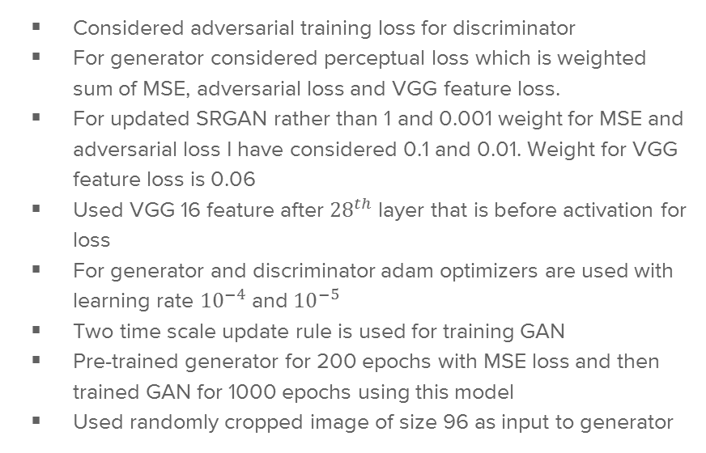
Technical Details
Considered adversarial training loss for discriminator
For generator considered perceptual loss which is weighted sum of MSE, adversarial loss and VGG feature loss.
For updated SRGAN rather than 1 and 0.001 weight for MSE and adversarial loss I have considered 0.1 and 0.01. Weight for VGG feature loss is 0.06
Used VGG 16 feature after ${28}^{th}$ layer that is before activation for loss
For generator and discriminator adam optimizers are used with learning rate ${10}^{−4}$ and ${10}^{−5}$
Two time scale update rule is used for training GAN
Pre-trained generator for 200 epochs with MSE loss and then trained GAN for 1000 epochs using this model
Used randomly cropped image of size 96 as input to generator
Notes:
Discuss the technical details including diagrams, algo, math etc.

Slide 5
Contributions (Novelty)
Implemented SRGAN for up sampling from LR image to HR by factor of 4
Tested it on DIV2k bicubic data set that has 800 training and 100 validation data.
Tried novel architecture for generator and discriminator by increasing depth and density of connections to get better performance
Considered variant of loss function to emphasis adversarial loss compare to MSE to get realistic images
While training GAN tried using best practices like lower learning rate for discriminator and two time scale update rule.
Notes:
Discuss your novel ideas and implementation

Slide 6
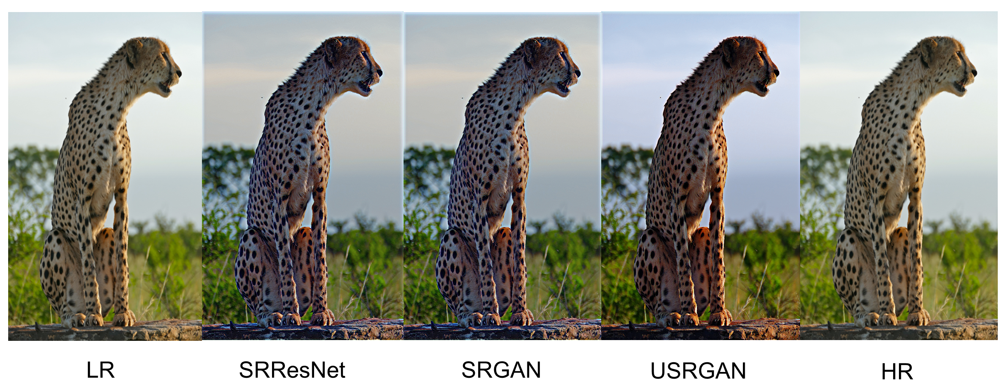
Results & Conclusion
PSNR and SSIM reduces for SRGAN and USRGAN
PSNR and SSIM does not capture perceptual information efficiently
Results are comparable with paper
For USRGAN contrast and perceptual quality has improved
 | SRResNet | SRGAN | USRGAN
PSNR (DB) | 24.0724 | 22.82 | 19.54
SSIM | 0.7245 | 0.6557 | 0.5699
Notes:
Discuss Results and highlight improvements over baseline

